Slide 2
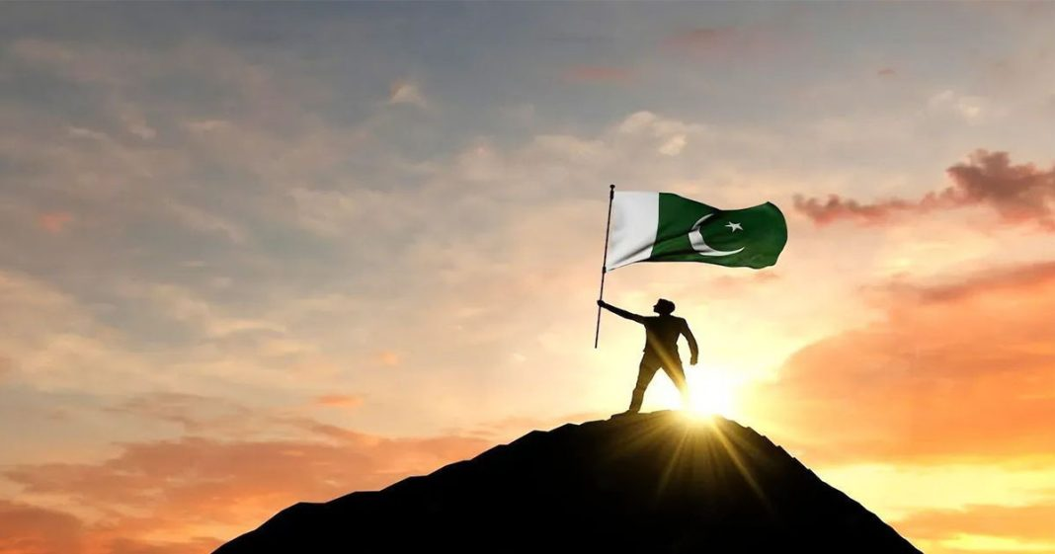
The Land of
ISLAMIC REPUBLIC OF PAKISTAN

Slide 3
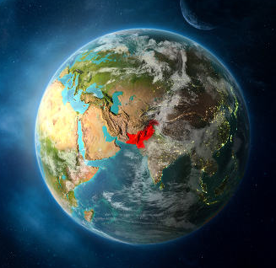
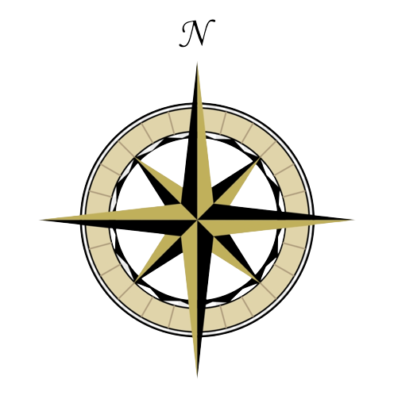
North
Latitude
23.35 To 37.05 Degrees North.
West
East
South
Longitude
60.50 To 77.05 Degrees
East.

Slide 4
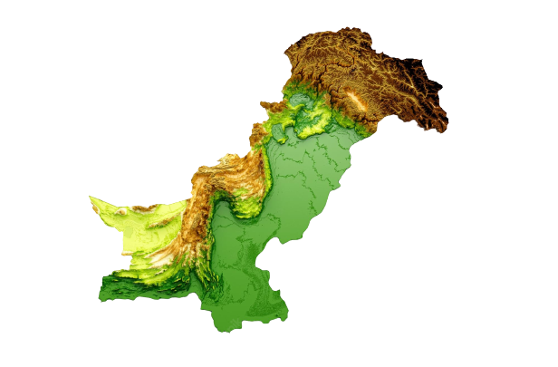
Area Of
PAKISTAN
7,96,096
Sq.KM

Slide 5
Areas of
Provinces Of PAKISTAN
Balochis tan
Punjab
Sindh
KPK
FATA
FC Islamabad
347,190 Sq.KM
205,345 Sq.KM
140,914 Sq.KM
74,521 Sq.KM
27,220 Sq.KM
906 Sq.KM

Slide 6
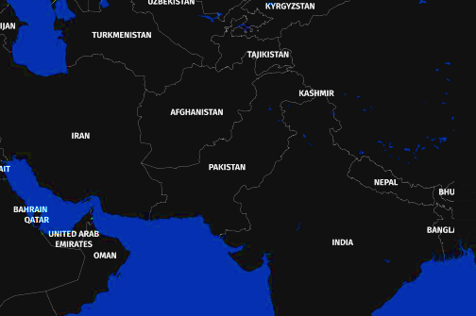
Neighboring countries
Iran
India
China
Afghanistan
800 KM
1610 KM
585 KM
2252 KM
Coastal line
700 KM

Slide 7

Importance of PAKISTAN’s
Location

Slide 8
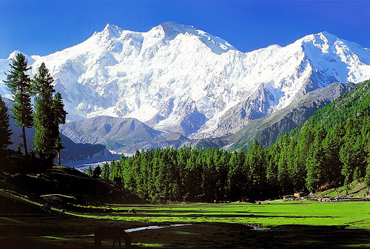
Physical Features Of PAKISTAN
The Land surface Of Pakistan divided into
Mountains.
Plateaus.
Plains.
Deserts.
Coastal Areas.

Slide 9
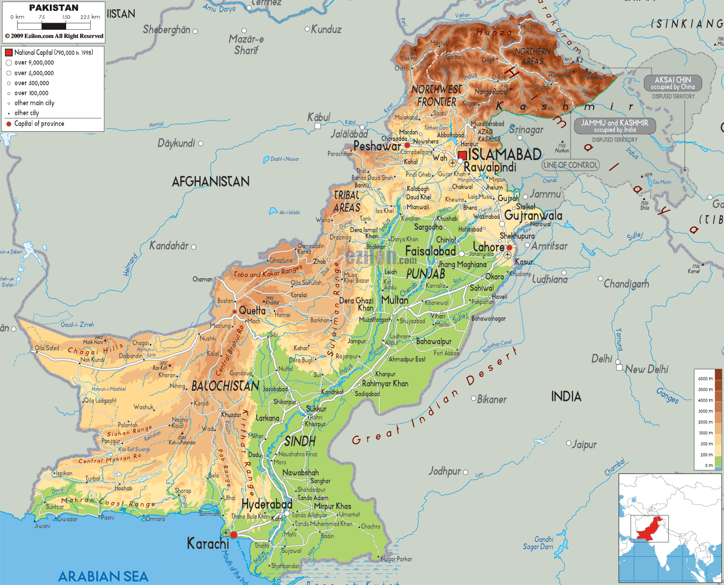
1. Mountains
North-Eastern and
Northern Mountains.
North-western and western Mountains.

Slide 10
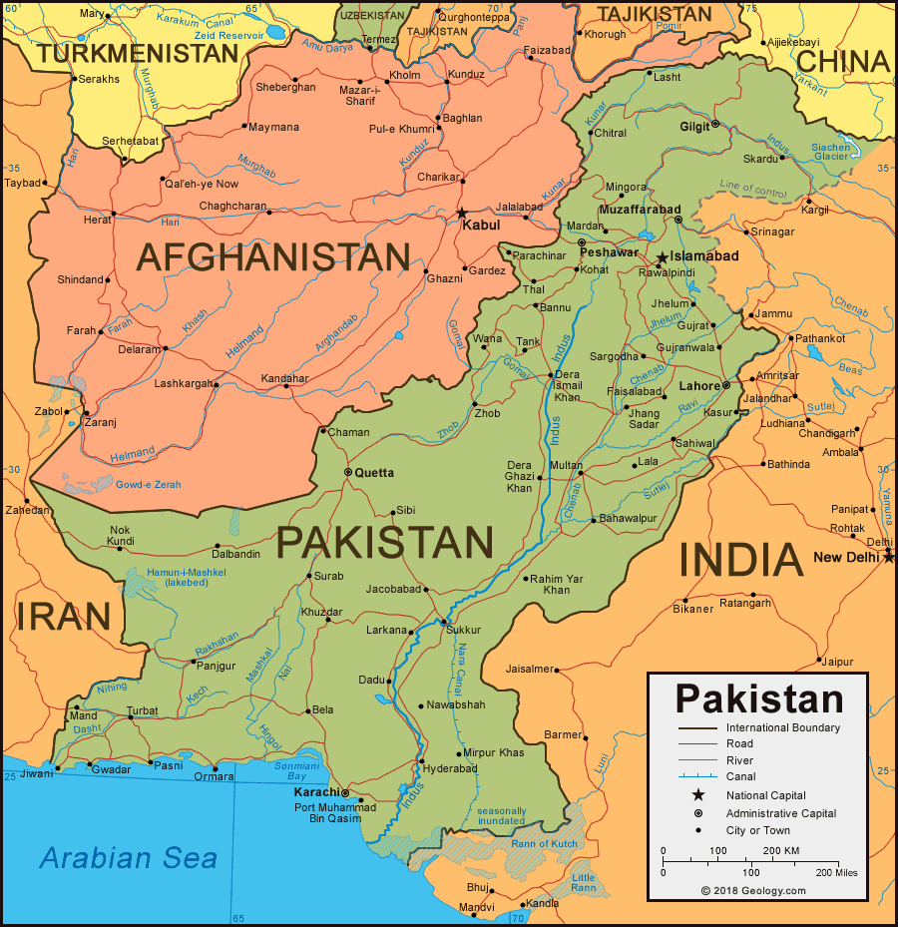
North-Eastern and Northern Mountains.
Himalaya is the highest Mountain of world.
2430 KM.
This range divided into four parts.

Slide 11
Himalaya Mountain.
Sub-Himalayas or siwalik .
(300 to 1000 meters).
Lesser Himalayas or Pir Panjal.
(1800 to 4600 meters).
Great Himalayas.
(6500 meters).
The Ladakh.
Highest Peak is Nanga Parbat (8126)

Slide 12
Karakoram Mountain.
This Range is about 7000 meters
in height.
The Highest peak of Pakistan & Second highest Peak of World GODWIN AUSTIN or K-2
(8611 meters) located in this Range.

Slide 13
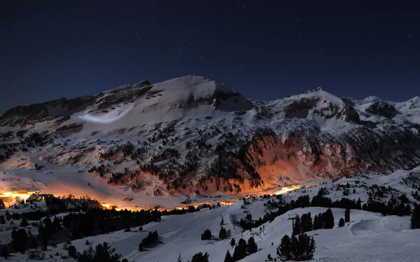
Importance of
North Eastern Mountain Range.
…..??

Slide 14
North-Western and Western
Mountains.
Also called Western branches of Himalayas
These are less in Height than North-Eastern Mountain.
Small rivers and passes are situated in these Mountains

Slide 15
Hindukush Range
The Greater part of this Range located in Afghanistan.
Tirich Mir (7690 meters)
is Highest of Peak of this
Range.

Slide 16
Koh-i-Safed Range
These are Between Khyber Pass & Kurram Pass.
Average Height 3600 Meters
The highest Point in this range is Sikeram.

Slide 17
Waziristan Hills
The area between Kurram Pass & Gomal Pass is know as Waziristan .
Average Height 1500-3000 Meters
The highest Point in this range is Sikeram.

Slide 18
Sulaiman Range
It’s Highest Peak is Takht-e-sulaiman (3487 meters).
Bolan Pass connects Quetta with Sibi.
A Railway line through Quetta connects to Iran.

Slide 19
Kirthar Range
These are low dry mountains.
On their South flow the HUB and LYARI rivers, which ultimately fall in the Arabian Sea Near Karachi.
The Highest point in this range is Gorakh.

Slide 20
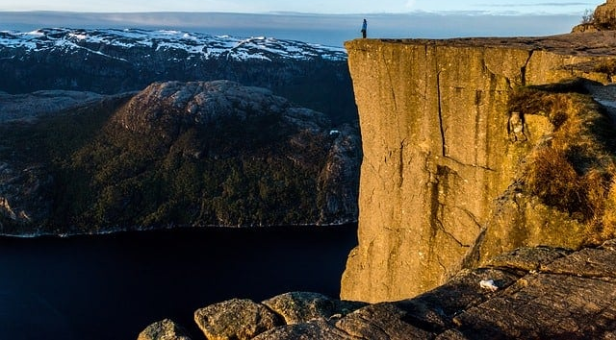
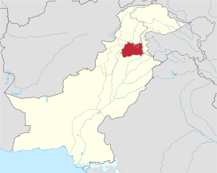
2. Plateaus
The Potwar Plateau.
Between Indus & Jhelum.
Height 300 to 600 meters.

Slide 21
2. Plateaus
The Balochis tan Plateau.
West of kirther mountains
Height 650 meters
Covered 40% area of Pakistan.

Slide 22
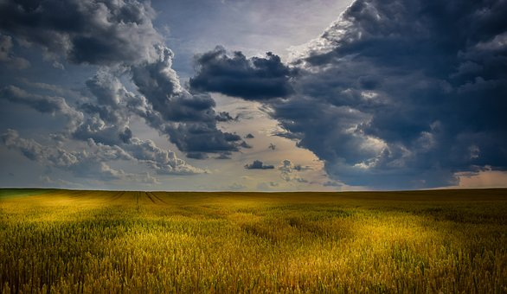
3.Plains
The Upper Indus Plain
The Lower Indus Plain
The Indus Delta

Slide 23
The Upper Indus Plain
It is between 200 to
300 meters above
sea level.
Greatest Canal System of the
World is operating in this plain
Which produce wheat,rice,
sugarcane,cotton,corn etc..

Slide 24
The Lower Indus Plain
Include most Areas of Sindh.
As Rainfall Low in this Region
Due to canal Irrigation, different
kinds of crops are grown.

Slide 25
The Indus Delta
Near Thatta it can gets divided
into many distributaries.
It covers about 40 KM.
Coconut and mangroves are
found in this area.

Slide 26
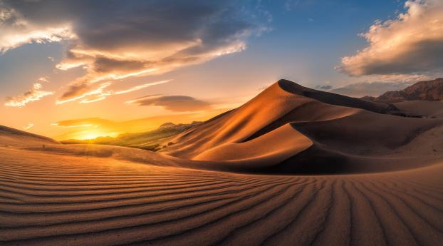
4. Deserts
Desert areas of Pakistan receive very low rainfall.
Some plains of Pakistan are also called semi-desert.
Located in Punjab & Sindh.

Slide 27
Thal Desert.
Cholistan Desert
Thar & Nara Desert.
The Chaghai & Kharan Desert.

Slide 28
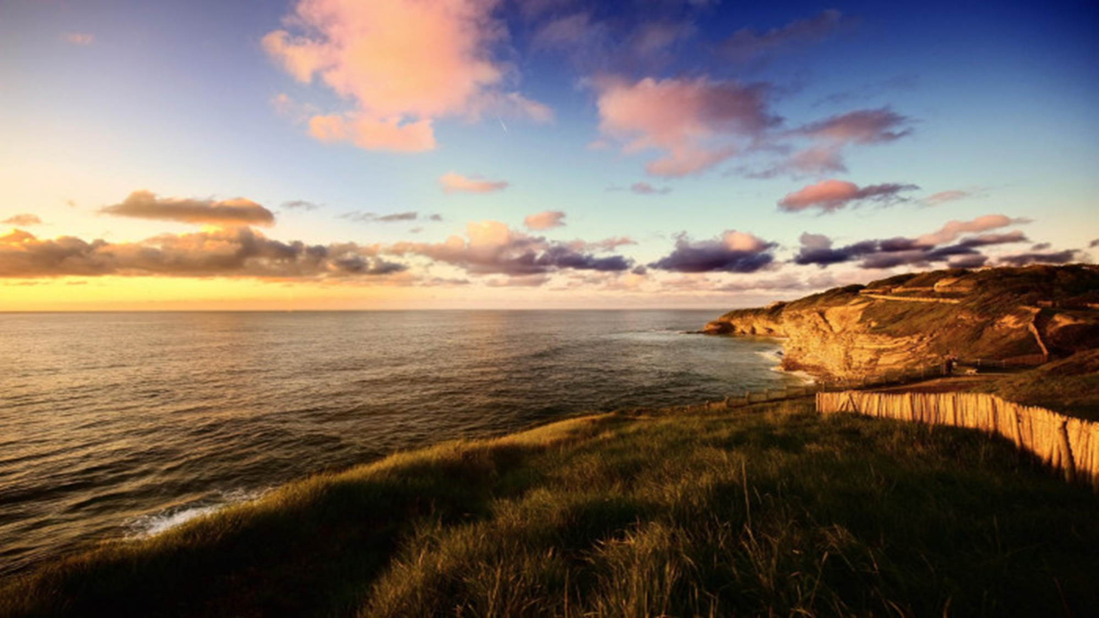
5.Coastal Areas
Pakistan Has 700 Sq.KM long Coastal areas.
The coast between the border of Iran & Hub river is called Makran coast. (500 km)
The Coast between Hub delta & Thatta(Badin) is about 200 KM.

Slide 29

All coastal areas of Pakistan are located on the Arabian Sea.
It has 3 Main Ports.
Port Qasim Jewani
Gwader Pasni
Omara Karachi Port

Slide 30
Thanks

